Slide 1
VxEOS
Components

Slide 2
VxEOS Components
Boot strap application VXEOS.OUT
Communication Engine
Communication Interface shared library
Network Control Panel
TCP/IP stack
SSL shared library
VeriFone Confidential

Slide 3
Boot Strap
Boot strap application VXEOS.OUT
  Started by the OS on start up (both cold and warm boot)
  It starts prior to the application specified in *GO
  Starts CommEngine and the executable files specified in the VxEOS manifest file
  It exits when finishes starting all desired applications
VeriFone Confidential

Slide 4
Communication Engine (CE)
Communication Engine
  Core component of the new communication infrastructure
  Provides application services:
    Obtain network events and status,
    Configure and query device drivers,
    Manage the network connection, etc.
  Applications must link with the CommEngine Interface Library (CEIF.LIB) for these services.
  Also used during download in system mode
VeriFone Confidential

Slide 5
Communication Engine (CE)
VXCE.OUT, started by boot strap application VXEOS.OUT
Starts the rest of the communication infrastructures, device drivers and TCP/IP stack
Identifies the communication devices present in a terminal and loads the correct device drivers.
Provides application services:
  Obtain network events & status
  Configure & query device drivers
  Manage network connections
VeriFone Confidential

Slide 6
Communication Engine (CE)
Exception
  *VCE in GID 1 affect CE invocation
    *VCE = 0, CE will not be started
    *VCE = non-zero, CE will be started normally
    *VCE does not exist, CE will be started normally
VeriFone Confidential

Slide 7
Communication Engine (CE)
CommEngine Device Management
  On start up, CE grabs the communication device(s) and starts the proper device driver(s)
  If a VMAC compliant application needs the comm device, CE needs to know this condition and wait for a notification before opening the device
  *CEDM is the variable that CE will check on start up.
    *CEDM = non-zero, CE will wait for notification
    *CEDM = 0, CE will grab device normally
    *CEDM does not exist, CE will grab device normally
VeriFone Confidential

Slide 8
Communication Engine (CE) - Configuration
EOS package has included default values
Network Configuration can be set via:
  Configuration Delta File
  GID1 CONFIG.SYS Parameters
Configuration Precedence
Location | Precedence
Default Value | Lowest
Delta File
CONFIG.SYS | Highest
VeriFone Confidential

Slide 9
Communication Engine (CE) - Configuration
Configuration Thru Delta File
  Named as VXCEHW.INI
  Contains section name and keys that application users can define
  Section and key names are not case sensitive
  Comments are marked by semi colon (;)
  Can contain blank lines using tabs and/or spaces
  Should be downloaded in GID1
VeriFone Confidential

Slide 10
Communication Engine (CE) - Configuration
Configuration File Section Names
Section Name | Description
ETH | Configuration section for ETHERNET media
PPPDIAL | Configuration section for PPP over Dial
DIAL | Configuration section for Dial no PPP
CDMA | Configuration section for CDMA
GPRS | Configuration section for GPRS
PPPGSM | Configuration section for PPP over GSM
GSM | Configuration section for GSM only (no PPP)
VeriFone Confidential

Slide 11
Communication Engine (CE) - Configuration
Configuration Key Names
Key Name | Description
startmode | States if NWIF is Auto or Manual
dhcp | 1 – Uses DHCP 0 – Static * Keys ipaddr, subnet, gateway, dns1 and dns2 are ignored if set to 1
ipaddr | IP address to be used
subnet | Subnet mask to be used
gateway | Gateway IP address
dns1 | Primary DNS
dns2 | Secondary DNS
username | Username used for PPP connection
password | Password used for PPP connection. Case sensitive
authtype | Authentication type used for PPP connection. 1 – NONE 3 - CHAP 2 – PAP 4 - MSCHAP
VeriFone Confidential

Slide 12
Communication Engine (CE) – Delta File Sample
[ETH]
startmode = Auto
dhcp = 0
ipaddr = 192.168.0.1
subnet = 255.255.255.0
gateway = 192.168.0.1
dns1 = 208.67.222.222
dns2 = 208.67.220.220
[PPPDIAL]
startmode = Manual
dhcp = 1
ipaddr =
subnet =
gateway =
dns1 =
dns2 =
username = verifone
; Pssword is case sensitive
password = 123456
authtype =
VeriFone Confidential

Slide 13
Communication Engine (CE) - Configuration
Configuration via CONFIG.SYS
  Stored in GID1
  Parameter is a combine section name and keyname separated by period.
  Format:
    <SectionName>.<KeyName> = <KeyValue>
  Example Entry:
    PPPDIAL.USERNAME = verifone
  CE reads CONFIG.SYS values at startup and updates the configuration delta file
  CONFIG.SYS values are deleted once the configuration delta file is updated
VeriFone Confidential

Slide 14
Communication Engine (CE) – CONFIG.SYS Sample
ETH.STARTMODE = AUTO
ETH.DHCP = 0
ETH.IPADDR = 192.168.0.100
ETH.SUBNET = 255.255.255.0
ETH.GATEWAY = 192.168.0.1
ETH.DNS1 = 208.67.222.222
ETH.DNS2 = 208.67.220.220
NOTE: Only the first letter is processed for STARTMODE
VeriFone Confidential

Slide 15
CommEngine Interface (CEIF)
CommEngine Interface Library
  A shared library resides in VxEOS
  CEIF.LIB, a bridge that connects a user application to CE
  Communicates with CommEngine through a named pipe called CEIF
  Application services provided are categorized as:
    Registration
    Device Management
    Communication infrastructure control
    Broadcast messages
    IP configuration
    Device Driver configuration
    Connection status & configuration query
VeriFone Confidential

Slide 16
CommEngine Interface (CEIF)
CommEngine Interface Library
  Application needs to include the following header files:
    ceif.h
    ceifConst.h
    vos_ddi_ini.h
  Link in the library stub file ceif.o
  Application header file must refer to N:15/CEIF.lib
  ( i.e., vrxhdr –lCEIF.LIB=N15:/CEIF.LIB )
VeriFone Confidential

Slide 17
CommEngine Interface (CEIF)
Network Interface (NWIF)
  A entity used for network connection management
  The network interface consists of the following elements:
    NWIF handle, for accessing a network interface
    Device
    Device driver
    Communication technology identifier
    NWIF configuration
    NWIF connection state & error
VeriFone Confidential

Slide 18
CommEngine Interface (CEIF)
Network Interface (NWIF)
  The data structure used to store NWIF information:
  typedef struct {
unsigned int niHandle; // Handle to Network Interface
char niCommTech[16]; // Null terminted string
char niDeviceName[32]; // /DEV/COMx /DEV/WLN1,/DEV/ETH1
unsigned int niRunState; // 1-Running, 2-Ready, 3-Not Ready, 0-Failed
int niErrorCode; // Error code associted with
unsigned int niStartUpMode; // 1—Auto startup, 0—Manual startup
char niDeviceDriverName [MAX_DRIVER_LEN+1];
int niDeviceDriverType; // Whether ETHERNET, Dial or PPP
} stNIInfo;
VeriFone Confidential

Slide 19
CommEngine Interface (CEIF)
API | Description
ceGetNWIFCount() | Obtain number of network interfaces (NWIF) supported.
ceGetNWIFInfo() | Obtain Network Interface information.
ceStartNWIF() | Starts all enabled network interfaces.
ceStopNWIF() | Stops all enabled network interfaces.
ceSetNWIFStartMode() | Specifies if the network interfaces are started at start up (auto mode) or need to be explicitly started (manual mode).
ceGetNWIFStartMode() | Obtain the current network interfaces start mode.
ceSetNWParamValue() | Specify IP and PPP configuration parameter value.
ceGetNWParamValue() | Fetch current IP and PPP configuration parameter value.
ceControlParamLock() | Lock the parameter files (network and device driver) associated with a network interface.
VeriFone Confidential

Slide 20
CommEngine Interface (CEIF)
Registration Functions
API | Description
ceRegister() | Registers application with CommEngine.
ceUnregister() | Cancels prior successful registration with CommEngine.
ceSetCommDevMgr() | Register application for device management.
VeriFone Confidential

Slide 21
CommEngine Interface (CEIF)
Device Management functions
API | Description
ceRequestDevice() | Request device from CommEngine.
ceRequestDeviceNotify() | Request the device from CommEngine. CommEngine will notify the application via user event when the device is available.
ceReleaseDevice() | Releases the device to CommEngine.
ceCancelDevice() | Cancels a previous device Request issued to CommEngine.
VeriFone Confidential

Slide 22
CommEngine Interface (CEIF)
Device Command functions
API | Description
ceGetDDParamValue() | Fetch device driver (DD) parameter.
ceSetDDParamValue() | Set device driver (DD) parameter.
ceExCommand() | Execute a command on the device and obtain response string.
VeriFone Confidential

Slide 23
CommEngine Interface (CEIF)
Dial Interface functions
API | Description
ceStartDialIF() | Starts the dial interface and provides the handle to device.
ceStopDialIF() | Stops the dial interface.
VeriFone Confidential

Slide 24
CommEngine Interface (CEIF)
Event Handling functions
API | Description
ceEnableEventNotification() | Enables notification of events from CommEngine. Application also registers callback function to be called when an event is posted.
ceDisableEventNotification() | Disables notification of events from CommEngine. After this call the application will no longer receive events.
ceIsEventNotificationEnabled() | Returns the current state of event notification.
VeriFone Confidential

Slide 25
CommEngine Interface (CEIF)
Logging & Misc. functions
API | Description
ceControlLog() | Start and stop CommEngine logging.
ceFetchLog() | Creates a copy of the log file as a text file at target location
ceActivateNCP() | Activates application VxNCP. On successful execution of this API, VxNCP has the focus and ownership of the console.
ceGetVersion() | Obtain version information for CommEngine Interface library and CommEngine.
VeriFone Confidential

Slide 26
VxEOS TCP/IP
VxEOS TCP/IP Stack
  An industry standard “off the shelf” TCP/IP stack ( TRECK TCP/IP stack) www.treck.com
  TCP, UDP, IPv4, ICMP, ARP, SLIP, RIPv2 Listener, Ping
  BSD 4.4 sockets libraries, documentation
VeriFone Confidential

Slide 27
VxEOS TCP/IP
To use the new TCP/IP stack
  Application must be linked with NET.LIB for stack related functions
  Include svc_net.h – contains normal socket functions prototype and various defines
  Link in svc_net.o - Network helper functions
  Must Link in NET.LIB – Stack related functions
  Must use Verix V SDK 3.3.0B or later
  Must have the following OS for each terminals:
    QA001225 for Predator Terminals such as Vx510
    QT52E20P for Vx520 (Trident)
    QT68E20Q for Vx680 (Trident)
VeriFone Confidential

Slide 28
VxEOS TCP/IP – Socket Functions
int socket (int family, int type, int protocol)
int bind (int sockfd, const struct sockaddr *myaddr, socklen_t addrlen)
int listen (int sockfd, int backlog)
int accept (int sockfd, struct sockaddr *cliaddr, socklen_t *addrlen)
int connect (int sockfd, const struct sockaddr *servaddr, socklen_t addrlen)
int setsockopt (int sockfd, int level, int optname, const void *optval, socklen_t optlen)
int getsockopt (int sockfd, int level, int optname, void *optval, socklen_t *optlen)
int recv (int sockfd, void *buff, size_t nbytes, int flags)
int send (int sockfd, const void *buff, size_t nbytes, int flags)
VeriFone Confidential

Slide 29
VxEOS TCP/IP – Socket Functions
int recvfrom (int sockfd, void * buff, size_t nbytes, int flags, struct sockaddr *from, socklen_t *addrlen)
int sendto (int sockfd, void * buff, size_t nbytes, int flags, const struct sockaddr *to, socklen_t addrlen)
int shutdown (int sockfd, int howto)
int socketclose (int sockfd)
int socketerrno(int sockfd)
int select(int maxfd, fd_set *in, fd_set *out, fd_set *ex, struct timeval *timeout)
int socketset_owner(int sockfd, int task_id)
int socketioctl(int sockfd, int cmd, int*arg)
int DnsGetHostByName(const char *hostname, in_addr_t *ip)
int gethostbyname(const char hostname, struct hostent he)
int blockingIO(int sockfd)
int in_addr_t inet_addr(char *strptr)
VeriFone Confidential

Slide 30
VxEOS TCP/IP – PING Functions
int PingOpenStart(const char *remoteHost, int seconds, int datalen)
  Opens an ICMP socket and starts sending PING echo requests to a remote host as specified by the remoteHostName parameter.
int PingGetStats(int sockfd, PingInfo *pingInfoptr)
  Gets Ping statistics in the ttPingInfo structure
int PingCloseStop(int sockfd)
  Stops the sending of any PING echo requests and closes the ICMP socket
VeriFone Confidential

Slide 31
VxEOS TCP/IP – ARP Functions
int AddArpEntry(ip_addr arpIpAddress, char *physAddrPtr, int physAddrLength)
int AddDefaultGateway(int handle, ip_addr gatewayIpAddress)
int AddProxyArpEntry(ip_addr arpIpAddress)
int AddStaticRoute(int handle, ip_addr destIpAddress, ip_addr destNetMask, ip_addr gateway, int hops)
int ArpFlush()
int DelArpEntryByIpAddr(ip_addr arpIpAddress)
int DelArpEntryByPhysAddr(char *physAddrPtr, int physAddrLength)
int DelDefaultGateway(ip_addr gatewayIpAddress)
int DelProxyArpEntry(ip_addr arpIpAddress)
int DelStaticRoute(ip_addr destIpAddress, ip_addr destNetMask)
int DisablePathMtuDisc(ip_addr destIpAddress, unsigned short pathMtu)
int GetArpEntryByIpAddr(ip_addr arpIpAddress, char *physAddrPtr, int physAddrLength)
int GetArpEntryByPhysAddr(char *physAddrPtr, int physAddrLen, ip_addr *arpIpAddressPtr)
int GetDefaultGateway(ip_addr *gwayIpAddPtr)
int RtDestExists(ip_addr destIpAddress, ip_addr destNetMask)
VeriFone Confidential

Slide 32
VxEOS – SSL
  Port of OpenSSL 0.9.8k with changes required to interface with VerixV security features such as hardware random number generator
IP stack socket functions do not interface to the SSL library so the SSL library must be called to use SSL.
Application source file needs to include ssl.h
Application needs to link in ssl.o – SSL stub functions.
Also used for IP downloads
Application header file must refer to N:15/SSL.lib
  ( i.e., vrxhdr –lSSL.LIB=N15:/SSL.LIB )
VeriFone Confidential

Slide 33
VxEOS – SSL and Crypto Functions Reference
SSL functions
  http://www.openssl.org/docs/ssl/ssl.html
Crypto functions
  http://www.openssl.org/docs/crypto/crypto.html
VeriFone Confidential

Slide 34
VxEOS – Network Control Panel
A self-contained Vx application
Resident on N: drive Group 46
Links same libraries available for applications
  TCP/IP Stack
  SSL
  CEIF
  OSDL
Default UI for all VxEOS components
  Configuration, Status & Management
  Software Downloads
  Network Diagnostics and Logging
  Device Drivers Configuration
Responsible to handle IP downloads from System Mode
VeriFone Confidential

Slide 35
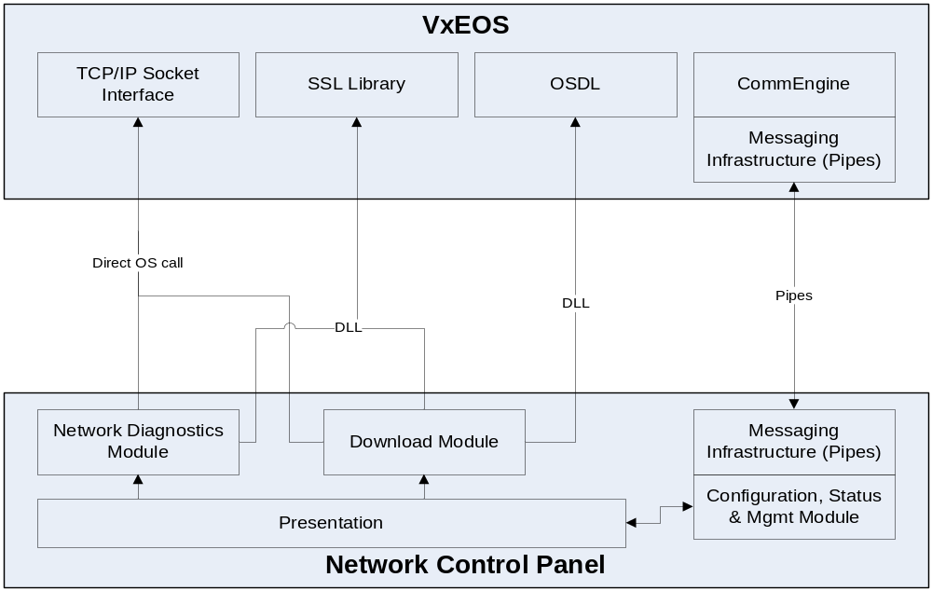
VxEOS – Network Control Panel
VeriFone Confidential

Slide 36
VxEOS – Network Control Panel
NCP startup
  By default, NCP is started up by VxEOS.OUT
  Can be disabled by setting the config.sys variable, *VXNCP
    *VXNCP = 0, NCP exits immediately
    *VXNCP = non-zero or not existing, NCP runs normally
  Once started, NCP creates communication channels with other EOS components
    Registers with CommEngine via ceAPI.
    Creates named PIPE “VXNCP” to communicate with other applications.
    Sit back, relax and wait for activation ☺
  What happen if failed to register with CommEngine?
    NCP will only provide services that do not involve CE and Device drivers
VeriFone Confidential

Slide 37
VxEOS – Network Control Panel
NCP Invocation
  A ceAPI, ceActivateNCP() is called to activate NCP
  The calling application will lose ownership of the CONSOLE. The task ID of this application is preserved in order to return the ownership of CONSOLE back to it.
NCP Termination
  While in idle state, if user select “Exit” or press “CANCEL” key, NCP will exit and return CONSOLE ownership to the calling application
VeriFone Confidential

Slide 38
VxEOS – Network Control Panel
Invoking App
ceAPI
VxNCP
OS
ceActivateNCP ()
disable_hot_key()
get_owner(VxNCP)
Pipe Message(P:VXNCP)
Activate_task(VXNCP)
Event:EVT_DEACTIVE
Event:EVT_ACTIVATE
Return:ceActivateNCP()
NCP Termination
enable_hot_key()
Activate_task(Invoking App)
Event:EVT_DEACTIVE
Event:EVT_ACTIVATE
VeriFone Confidential

Slide 39
VxEOS – Network Control Panel
IP Download in System Mode
  Download via Dial is still handled by OS
  VxEOS will handle IP download if *ZTCP is not configured
  Two parameters are passed to NCP to handle download
    Arg1: download type, ‘F’ for full or ‘P’ for partial
    Arg2: download group, always use two digits, 01 or 03 …
  NCP will prompt for *ZA, *ZT and *ZP if not present
  IP download from VeriCenter has an option for SSL download. NCP will prompt the user for selection. If *ZSEC is set, NCP will not prompt the user to select SSL download from VeriCenter
VeriFone Confidential

Slide 40
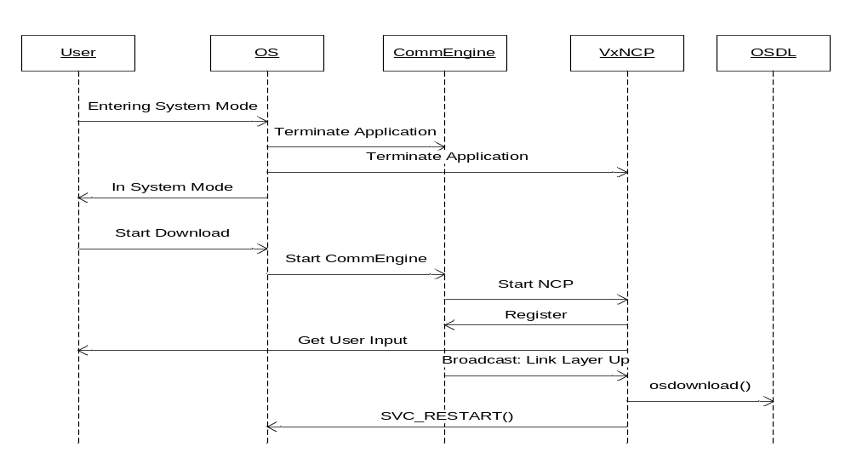
VxEOS – Network Control Panel
VeriFone Confidential

Slide 41
VxEOS – Network Control Panel
NCP under VMAC environment
  NCP started before VMAC, cannot register with VMAC/IMM
  Neither CE nor NCP are VMAC compliant – cannot handle device requests
  VMAC Interface (VMACIF) is a bridge application running between VMAC and VxEOS components
  *CEDM determines if CE will work in VMAC mode or not
    *CEDM=0 or not exist, No VMAC
    *CEDM=1, in VMAC environment, need to work with VMACIF for device management
  VMACIF.OUT is started by VMAC and can run in GID 1-15
  VMACIF registers with both VMAC and CE
  VMACIF also registers with CE as device management app
VeriFone Confidential

Slide 42
VxEOS – Network Control Panel
NCP under VMAC environment (continued)
  VMACIF working with CE
    Device Push (VMACIF -> CE)
    by using ceAPI ceReleaseDevice()
    Device Pull (CE -> VMACIF )
    by using ceAPI ceRequestDevice()
  VMACIF working with NCP
    VMACIF registered with VMAC and shows up in a VMAC menu as VxNCP
    When a user select VxNCP, VMACIF will activate NCP
    When a user leaves NCP, control is returned to VMACIF and then VMAC
VeriFone Confidential

Slide 43
VxEOS – VxNCP Application – Data Files
External configuration/customization for VxEOS components
  Single text based file format used for all VxEOS components
  Files will be using .INI extension
  File contains tables, table contains records, record has attributes
  VeriFone factory default settings are placed in GID46
  Customer default deployment settings are placed in GID1. Also known as Delta Files
  Settings are retrieved as follow
    Read default settings from GID46
    Override defaults with settings in GID1
    Run time changes possible via CEIF
    Manual changes possible via VxNCP UI
    All changes are saved in GID1 and become new startup defaults
    Restoring default/original settings will be available via VxNCP UI
VeriFone Confidential

Slide 44
VxEOS – VxNCP Application – Sample GPRS Delta File
;;;;;;;;;;;;;;;;;;;;;;;;;;;;;;;;;;;;;;;;
; GPRS Siemes MC55i driver INI file.
; ;;;;;;;;;;;;;;;;;;;;;;;;;;;;;;;;;;;;;;;
[ Default ]
; GPRS driver version
DRIVER_VER = "GPRS 1.0.0.11"
; Does the driver support AT commands?
SUPP_AT = 1
; Does the driver report signal strength information?
SUPP_RSSI = 1
;;;;;;;;;;;;;;;;;;;;;;;;;;;;;;;;;;;;;;;; The following are the state machine
; timeouts.
; These are generic for all DDI drivers ; as they relate to state retries and
; not are not implementation specific
;;;;;;;;;;;;;;;;;;;;;;;;;;;;;;;;;;;;;;;
;;;;;;;;;;;;;;;;;;;;;;;;;;;;;;;;;;;;;;;
; Total time waiting for link-up is
; link_retries * link_retry_timeout
; Timeout values are in milliseconds
; Number of network retries and
; timeouts before error
;;;;;;;;;;;;;;;;;;;;;;;;;;;;;;;;;;;;;;;
; Maximum connection retries
CONN_RET = 5
; Maximum retries during poor network
; coverage
PR_NET_RET = 5
; Maximum retries during no network
; coverage
NO_NET_RET = 5
; Network retry timeout in milliseconds
NET_RET_TM = 1000
; Connection retry timeout in
; milliseconds
CONNRET_TM = 1000
; Time interval to check connection
; status
CONNCHK_TM = 500
VeriFone Confidential

Slide 45
VxEOS – VxNCP Application – Sample GPRS Delta File
;;;;;;;;;;;;;;;;;;;;;;;;;;;;;;;;;;;;;;;; Device specific parameters
; ;;;;;;;;;;;;;;;;;;;;;;;;;;;;;;;;;;;;;;;
; WARNING: Do not modify the following
; response codes and values
;;;;;;;;;;;;;;;;;;;;;;;;;;;;;;;;;;;;;;;
; Modem response values
; OK , 0
; CONNECT_SUCCESS , 1
; RING , 2
; NO_CARRIER , 3
; ERROR , 4
; NADA,5
; DIAL_TONE , 6
; BUSY , 7
; NO_ANSWER , 8
; Non verbose response codes
resp_0=0
resp_1=1
resp_2=2
resp_3=3
resp_4=4
resp_5=5
resp_6=6
resp_7=7
resp_8=8
;;;;;;;;;;;;;;;;;;;;;;;;;;;;;;;;;;;;;;;
; AT response regular expressions:
; Default regular expressions are
; defined here for configurabilities
; sake
;;;;;;;;;;;;;;;;;;;;;;;;;;;;;;;;;;;;;;;
verbal_response_exp = "^\([A-Z 0-9]*\)[^A-Z 0-9]*$"
numeric_response_exp = "^\([0-9]*\)[^A-Z 0-9]*$"
any_response_exp = "^\(..*\)$"
;;;;;;;;;;;;;;;;;;;;;;;;;;;;;;;;;;;;;;;
; GPRS NON CONFIGURABLE PARAMETERS
; These are for the general operation
; of the DDI Driver; not network
; specific.
;;;;;;;;;;;;;;;;;;;;;;;;;;;;;;;;;;;;;;;
; AT Command: Start up string
gprs_start = "ATE0Q0V0"
; AT Command: Start up string for the Multiplexed channel 1
gprs_start_mux1 = "ATE0Q0V0"
; AT Command: Start up string for the Multiplexed channel 2
gprs_start_mux2 = "ATE0Q0V0“
VeriFone Confidential

Slide 46
VxEOS – VxNCP Application – Sample GPRS Delta File
; AT Command: Hang up string
gprs_hangup = "ATH"
; AT Command: Dial string (Format: ATD<gprs_primary>)
gprs_dial = "ATD"
; AT Command: GPRS Attach
gprs_attach = "AT+CGATT=1"
; AT Command; Define PDP Context
; (Format:AT+CGDCONT=1,"IP",<gprs_apn>)
gprs_protocol_init = "AT+CGDCONT=1,IP"
; AT Command: Signal Quality (RSSI)
gprs_signal_status = "AT+CSQ"
gprs_signal_exp = "^.CSQ..\([0-9]*\).[0-9]*[^A-Z 0-9]*$"
; AT Command: Firmware Version
gprs_fw_ver = "AT+CGMR"
gprs_fw_ver_exp = "^REVISION \([0-9]*\.[0-9]*\)[^A-Z 0-9]*$"
; AT Command: Serial number
; identification (IMEI)
gprs_imei = "AT+CGSN"
gprs_imei_exp = "^\([A-Z 0-9]*\)[^A-Z 0-9]*$"
; AT Command: SIM card identification number (ICCID)
gprs_iccid = "AT^SCID"
gprs_iccid_exp = "^\^SCID: \([0-9]*\)[^A-Z 0-9]*$"
; AT Command: Internation Mobile Subscriber Identity (IMSI)
gprs_imsi = "AT+CIMI"
gprs_imsi_exp = "^\([A-Z 0-9]*\)[^A-Z 0-9]*$"
;;;;;;;;;;;;;;;;;;;;;;;;;;;;;;;;;;;;;;;;;;;;;;;;;;;;;
; Up to 4 init strings allowed - comment out if not
; required
; The OS will provide the multiplexer protocol
; gprs_init_2
; gprs_init_3
; gprs_init_4
;;;;;;;;;;;;;;;;;;;;;;;;;;;;;;;;;;;;;;;;;;;;;;;;;;;;;
; Initialization String/s
gprs_init_1 = "AT&D2&S1&C1\Q3X4"
gprs_init_2 = "AT+CFUN=7"
; Initialization String 1 of the multiplexed
; channel 1
; gprs_init_mux1_1 =
; Initialization String 1 of the multiplexed
; channel 2
; gprs_init_mux2_1 =
VeriFone Confidential

Slide 47
VxEOS – VxNCP Application – Sample GPRS Delta File
; The number of retries spent in trying
; "gprs_start"
GP_INIT_RT = 3
; The number of attempts the driver would check if the modem responds during power up
GP_POWR_RT = 3
;;;;;;;;;;;;;;;;;;;;;;;;;;;;;;;;;;;;;;;;;;;;;;;;;;;;;
; Communication settings
;;;;;;;;;;;;;;;;;;;;;;;;;;;;;;;;;;;;;;;;;;;;;;;;;;;;;
; A value of 9 (115200) is the optimal baud rate for
; this driver
gprs_baud = 9
; Communication port
gprs_port = "/DEV/COM2"
; Serial port format as defined by the SDK
; Fmt_A8N1 = 4 async, 8 data bits, no parity, one
; stop
; WARNING: The format should always be Fmt_A8N1
gprs_format = 4
; Command port - the logical device handle for the
; second channel of the multiplexer
gprs_command_port = "/DEV/GMX1“
; Communication port OS EVENT MASK (EVT_COM2 = 1L<<7)
; WARNING: Should always be 128
gprs_os_event_mask = 128
;;;;;;;;;;;;;;;;;;;;;;;;;;;;;;;;;;;;;;;
; Timeouts and retries
;;;;;;;;;;;;;;;;;;;;;;;;;;;;;;;;;;;;;;;
; Send AT Command timeout (ms)
GP_SEND_TO = 20000
; Response timeout after sending an AT
; command (ms)
GP_RESP_TO = 20000
; Data connection timeout (ms)
GP_CONN_TO = 40000
; Data disconnection timeout (ms)
GP_DISC_TO = 20000
; Using a single intecharacter timeout
; for all AT commands (ms)
GP_CHAR_TO = 2000
; Number of millisenconds to wait
; between sending AT commands
GP_ATDELAY = 2000
; GPRS network attach timeout (ms)
; (Siemens AT command documentation
; states attachment timeout is 5
; minutes)
GP_ATCH_TO = 300000
VeriFone Confidential

Slide 48
VxEOS – VxNCP Application – Sample GPRS Delta File
; SIM PIN
GP_SIM_PIN = “CustomerSIMPIN”
; SIM PUK
GP_SIM_PUK = “CustomerSIMPUK”
; Minimum Signal Strength allowed for a connection to
; succeed
GP_MINRSSI = 10
; Use hardware flow control - boolean
gprs_hw_flow_control = true
;;;;;;;;;;;;;;;;;;;;;;;;;;;;;;;;;;;;;;;
; Power-saving configuration
;;;;;;;;;;;;;;;;;;;;;;;;;;;;;;;;;;;;;;;
; Minimum battery charge percentage
GP_LOWBATT = 10
;;;;;;;;;;;;;;;;;;;;;;;;;;;;;;;;;;;;;;;
; GPRS CONFIGURABLE PARAMETERS
; These parameters can be configured
; using NCP
;;;;;;;;;;;;;;;;;;;;;;;;;;;;;;;;;;;;;;;
; GPRS Access Point Name
GP_APN = “CustomerAPN”
; Primary number to dial
GP_PRIMARY = "*99***1#"
; GRPS monitor switch
GP_MONITOR = false
VeriFone Confidential

Slide 49
VxEOS – VxNCP Application –DDI Config Parameters
DDI config .INI variables can be override or retrieved thru:
  ceSetDDParamValue ()
  ceGetDDParamValue ()
Refer on the .INI file to change which parameter to be configured
Sample GPRS Configurable parameters:
  GP_APN
  GP_PRIMARY
  GP_MONITOR
  GP_SIM_PIN
  GP_SIM_PUK
  GP_MINRSSI
VeriFone Confidential

Slide 50
VxEOS – EOSLog Library
Replacement of LogSys for terminal running VxEOS compatible OS
Utilize the Vx system logging mechanism, thus resulted in an integrated log (OS, VxEOS component, and application information) can now be captured.
Released as a shared library
Package including:
  eoslog.h – defines the logging macros
  elog.o – interface file for app using RVDS 2.1
  elogn.o – interface file for app using RVDS 4.0
  elog.lib{! – Shared library file, download to F:15
  elog.lib.p7s{! – signature file, download to I:15
Application will link with .o file but need to replace it with vrxhdr
vrxhdr app.out –Lelog.lib=N:/elog.lib
VeriFone Confidential

Slide 51
VxEOS – EOSLog Library
LOGSYS_FLAG must be defined, a good place to do this is in the makefile
For existing application to migrate to EOSLog, application must include eoslog.h instead of LogSys.h
New API style for EOSLog – printf style
  Default format is still using double parenthese, e.g.,
  LOG_PRINTF ((“Test %d”, i));
  LOG_PRINTFF ((FILTER_THIS, “Start %d”, read-ticks()));
  New feature – define LOGSYS_NEW_API_STYLE before including eoslog.h header file, a single parentheses can be used:
  LOG_PRINTF (“Test %d”, i);
  LOG_PRINTFF (FILTER_THIS, “Start %d”, read-ticks());
VeriFone Confidential

Slide 52
VxEOS – EOSLog Library – CommEngine Logging
CELOG=C - Enables CommEngine logging
CELOG=N - Disables CommEngine logging
CEFIL - Defines CE logging filter
CEFIL defined values:
  0x00000010 - High level logging
  0x00000020 - Detailed logging
  0x00000030 - Combines both high level and detailed logging
  0x00000040 - Logs API parameter and return values
  0x00000080 - Logs pipe handling and memory tracking
  0x00010000 - Logs DDI management and DDI tools
  0x00040000 - DDI driver logging
  0x00080000 - Log errors related to DDI management and tools
VeriFone Confidential

Slide 53
VxEOS – EOSLog Library – VxNCP and VxCTLS Logging
VXNCPLOG=C - Enables VxNCP logging
VXNCPLOG=N - Disables VxNCP logging
VXNCPFIL
  By default, cannot be filtered out
  Only used to generate detailed logging info on parsing .INI
  Must be configured as 0x80000000
VXCTLSLOG=C - Enables VxCTLS logging
VXCTLSLOG=N - Disables VxCTLS logging
VXCTLSLFIL - Used to define logging VxCTLS logging filter:
  0x00000000008 - Logs call to PICC L1 driver
  0x00000000080 - Logs event related to loading, switching and calling card handlers
  0x00000000100 - Logs UI related messages sent to client apps
  0x01000000000 - Logs command messages sent and received
  0x00000000001 - Application state logging
  0x10000000000 - Application crypto operations logging
VeriFone Confidential

Slide 54
VxEOS Package
A VxEOS certificate for GID 46
Package will come preinstalled
  GID 46
    Read-only from System Mode
    Not accessible by applications at run time
  N:15
    Files are shared and read-only file
    N: Pre-installed
    GID 15, public for all applications
  GID 0
    OS only files
Clearing all memory does not delete N: drive or GID46. Similar to the current OS, VxEOS is persistent
VeriFone Confidential

Slide 55
EOS Package Pictorial
N: GID 0 | GID 1 | N:GID 15 | N:GID 46
tcpip.bin | VXCEHW.INI | CEIF.LIB | VXEOS.OUT
 | VXNCP.INI | SSL.LIB | VXCE.OUT
 | ETGN000I.INI | ELOG.LIB | VXNCP.OUT
 | DLCX_ALL.INI | NET.LIB | VXCEHW.INI
 |  |  | VXNCP.INI
 |  |  | ETGN000I.LIB
 |  |  | DLCX_ALL.LIB
 |  |  | ETGN000I.INI
 |  |  | DLCX_ALL.INI
 |  |  | ETGN000I.MTD
 |  |  | DLCX_ALL.MTD
VeriFone Confidential

Slide 56
EOS Package Apps
Qxxxxx - Terminal OS
  Add support for N: and Group 46
VxEOS.OUT - EOS bootstrapping application
VxCE.OUT - CommEngine
VxTCP.BIN - TCP/IP stack
VxNCP.OUT - Network Control Panel
DLCX_ALL.LIB - Conexant Dial DDI Driver
ETGN000I.LIB - Internal Ethernet DDI Driver
DLCX_ALL.INI - Conexant Dial INI File
ETGN000I.INI - Internal Ethernet INI File
DLCX_ALL.MTD - Conexant Dial Metadata
ETGN000I.MTD - Internal Ethernet Metadata
VeriFone Confidential

Slide 57
EOS Package Libraries
CEIF.LIB - CommEngine Interface library
SSL.LIB - OpenSSL library
ELOG.LIB - EOS debug logging functions
NET.LIB - Shared library for stack related functions
VCS for EOS - Corporate VCS ported to EOS
VMACIF.OUT - A bridge application working between VMAC and VxEOS components.
VeriFone Confidential

